Slide 1
Methods of conducting semi-structured interview through video conference software(Zoom, google meet)
Akhter Al Amin 2nd Year PhD Student CAIR Lab, RIT

Slide 2
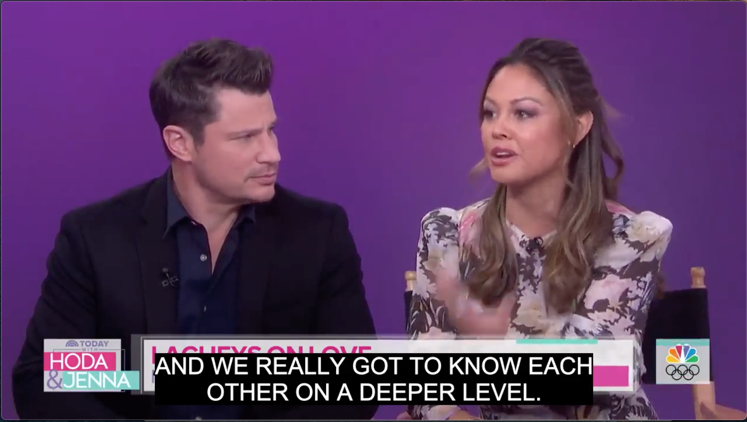
My Research Projects
Automatic Caption Evaluation Metric for people who are Deaf and Hard of Hearing.
Modeling Facial Expression of American Sign Language users.
AND WE REALLY GO TO NO EACH OTHER ON DEEPER LEVEL.
Actually Shown
Actually Spoken

Slide 3


What challenges covid-19 brings for HCI researchers in conducting interview?
Data Collection
Experiment Design
Privacy
Notes:
digitalmethods.net
https://weworkremotely.com/

Slide 4
Possible Approach
Data Collection
Develop Website (Best Framework: jsPsych)
Google Form
SurveyMonkey or others
Experiment Design
IRB approval
Recording Video???
Digitally Signed Consent Form
Browser Compatibility
Privacy
Private Zoom/Google Room
Limited Time Video Storage
Payment Information

Slide 5
Hypothetical Pros and Cons
Pros
Participants’ Economic and Time Savings.
Circumstantial Precondition Ensured.
Convenient Monitoring.
Convenient Communication Setup.
Cons
Continuous Communication and Reminder.
Handling Technical Difficulties.
Instant Decision Making.
Lengthy Payment Process.
Notes:
SOme experiment requires exactly same environment where participants experience such in their home. Thats why in HCI, some lab has a homely settings such as bed room, living room.
Instant decision making during question answer.

Slide 6

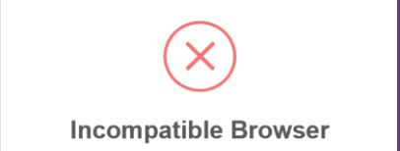
Learning from Experience
Scenario: Camera Broken
Unable to watch facial expression.
Unable to ask any follow-up question.
Scenario: Incompatible Browser
Consume experiment time.
Recording verbal response.
Notes:
Such as, we identified participant camera is broken, only we asked our participant to share their screen. In that case, any kind of
Image Curtesy:
Techjunkie.com
pngegg.com

Slide 7

Robust Solution(Be Panicked)

Slide 8
New Normal Experimental Pathway
Pre-study Activities
In-study Activities
Post- study Activities

Slide 9
Pre-study Activity
Make sure IRB is prepared.
Know your participant.
Ask specific question.
Contact twice.
Consent form digitally signed.
Exact Browser compatibility of study website.
Plan verbal questions.
Notes:
3 days before and 1 day before

Slide 10
In-study Activity
Be ontime.
Check consent form.
Mention before starting record.
Mini ice-breaking session.
Intervene immediately after participants’ response.
Do not intervene while participant is thinking.
Remember participant might be in stress.
Explain as much as possible.
Notes:
-- stress because it is difficult time for everyone.

Slide 11
Post-study Activity
Don’t forget to fill up demographic form.
Don’t forget to collect payment information.
Ask whether it is okay to follow-up.
If website fails to record, fill out watching recording.
Prepare multiple device for consecutive study.
Notes:
-- since uploading recorded video takes 1 to 2 hours and at that time, it might be impossible to conduct study.

Slide 12
Open Discussion
Did you conduct any remote study during this time?
What are the unexpected scenario you encountered?
How did you resolve those?
What makes you more comfortable or uncomfortable about this remote study?

Slide 13
Thank You
Presentation Link: https://github.com/akhteralamin/presentations
Contact Information:
Email: aa7510@rit.edu
Website: https://people.rit.edu/aa7510/#
Lab: http://latlab.ist.rit.edu
Center: http://cair.rit.edu
Linked in: http://www.linkedin.com/in/akhteralamin

